Slide 1
ECE 471/571 – Lecture 21
Decision Tree
11/17/14

Slide 2
Nominal Data
Descriptions that are discrete and without any natural notion of similarity or even ordering

Slide 3
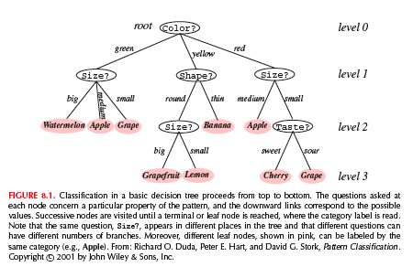
Some Terminologies
Decision tree
  Root
  Link (branch) - directional
  Leaf
  Descendent node

Slide 4
CART
Classification and regression trees
A generic tree growing methodology
Issues studied
  How many splits from a node?
  Which property to test at each node?
  When to declare a leaf?
  How to prune a large, redundant tree?
  If the leaf is impure, how to classify?
  How to handle missing data?

Slide 5
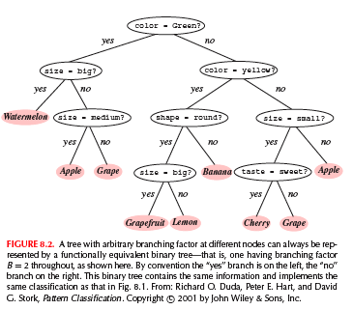
Number of Splits
Binary tree
Expressive power and comparative simplicity in training

Slide 6
Node Impurity – Occam’s Razor
The fundamental principle underlying tree creation is that of simplicity: we prefer simple, compact tree with few nodes
http://math.ucr.edu/home/baez/physics/occam.html
Occam's (or Ockham's) razor is a principle attributed to the 14th century logician and Franciscan friar; William of Occam. Ockham was the village in the English county of Surrey where he was born.
The principle states that “Entities should not be multiplied unnecessarily.”
"when you have two competing theories which make exactly the same predictions, the one that is simpler is the better.“
Stephen Hawking explains in A Brief History of Time: “We could still imagine that there is a set of laws that determines events completely for some supernatural being, who could observe the present state of the universe without disturbing it. However, such models of the universe are not of much interest to us mortals. It seems better to employ the principle known as Occam's razor and cut out all the features of the theory which cannot be observed.”
Everything should be made as simple as possible, but not simpler

Slide 7
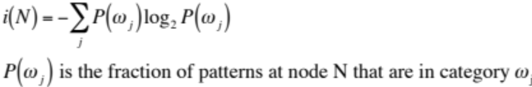
Property Query and Impurity Measurement
We seek a property query T at each node N that makes the data reaching the immediate descendent nodes as pure as possible
We want i(N) to be 0 if all the patterns reach the node bear the same category label
Entropy impurity (information impurity)

Slide 8

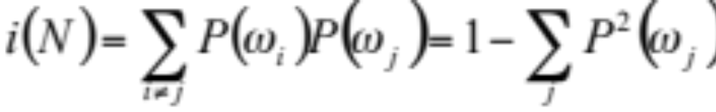
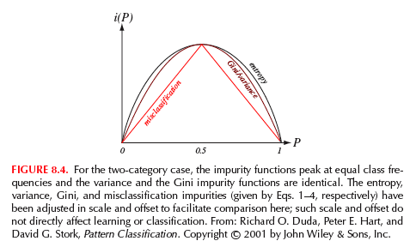
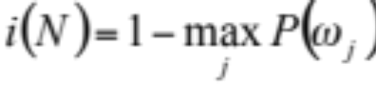
Other Impurity Measurements
Variance impurity (2-category case)
Gini impurity
Misclassification impurity

Slide 9
Choose the Property Test?
Choose the query that decreases the impurity as much as possible
  N_{L}, N_{R}: left and right descendent nodes
  i(N_{L}), i(N_{R}): impurities
  P_{L}: fraction of patterns at node N that will go to N_{L}
Solve for extrema (local extrema)

Slide 10
Example
Node N:
  90 patterns in ω₁
  10 patterns in ω₂
Split candidate:
  70 ω₁ patterns & 0 ω₂ patterns to the right
  20 ω₁ patterns & 10 ω₂ patterns to the left
Notes:
If using Gini impurity, i(N)=0.18, di(n) = 0.18→ 0.13
If using misclassification impurity, i(N)=0.1, di(N)=0.1→0.1

Slide 11
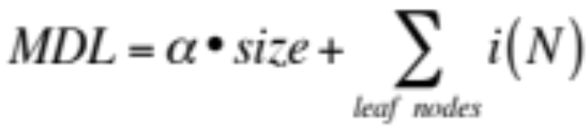
When to Stop Splitting?
Two extreme scenarios
  Overfitting (each leaf is one sample)
  High error rate
Approaches
  Validation and cross-validation
    90% of the data set as training data
    10% of the data set as validation data
  Use threshold
    Unbalanced tree
    Hard to choose threshold
  Minimum description length (MDL)
    i(N) measures the uncertainty of the training data
    Size of the tree measures the complexity of the classifier itself
Notes:
Size: number of nodes

Slide 12
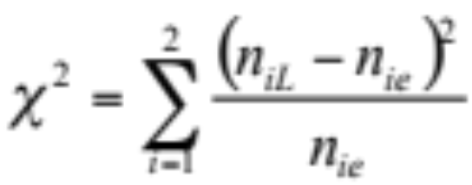
When to Stop Splitting? (cont’)
Use stopping criterion based on the statistical significance of the reduction of impurity
  Use chi-square statistic
  Whether the candidate split differs significantly from a random split

Slide 13
Pruning
Another way to stop splitting
Horizon effect
  Lack of sufficient look ahead
Let the tree fully grow, i.e. beyond any putative horizon, then all pairs of neighboring leaf nodes are considered for elimination

Slide 14
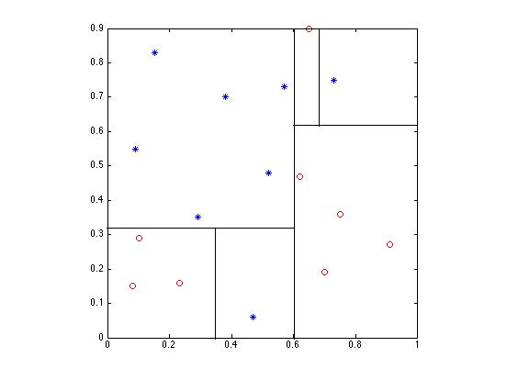
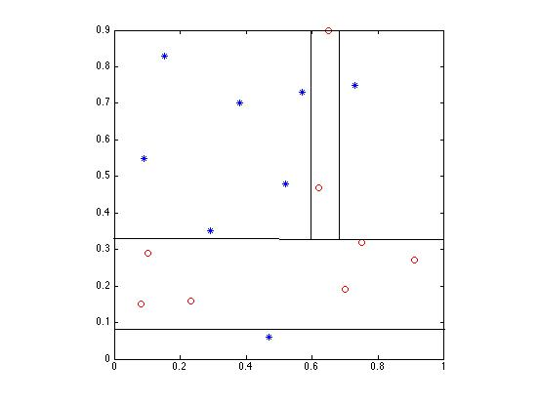
Instability

Slide 15
Other Methods
Quinlan’s ID3
C4.5 (successor and refinement of ID3)
http://www.rulequest.com/Personal/

Slide 16
MATLAB Routine
classregtree
Classification tree vs. Regression tree
  If the target variable is categorical or numeric
http://www.mathworks.com/help/stats/classregtree.html
Notes:
e.g., predicted price of a consumer good

Slide 17
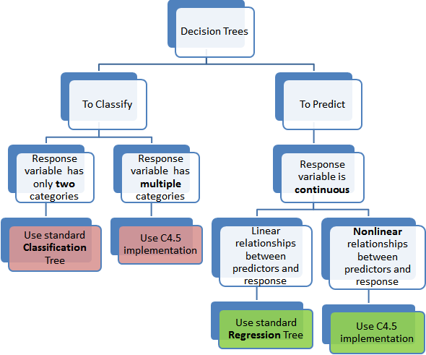
http://www.simafore.com/blog/bid/62482/2-main-differences-between-classification-and-regression-trees

